Slide 1
The Ecosystem Concept

Slide 2
What is ecosystem ecology?

Slide 3
Ecology: definition
The study of the relationships between organisms and:
Each other
The environment

Slide 4
Ecology: definition
The study of the relationships between organisms and:
Abiotic environment
Biotic environment

Slide 5
What aspects of the abiotic and biotic environment influence organismal functioning?
Notes:
Take a few minutes to discuss

Slide 6
Hierarchy of Ecology
Physio-logical Ecology

Slide 7
Hierarchy of Ecology
Physio-logical Ecology
Population Ecology

Slide 8
Hierarchy of Ecology
Physio-logical Ecology
Population Ecology
Community Ecology

Slide 9
Hierarchy of Ecology
Physio-logical Ecology
Population Ecology
Community Ecology
Ecosystem Ecology

Slide 10
Ecosystem ecology is the study of the interactions between organisms and their environment as an integrated system

Slide 11
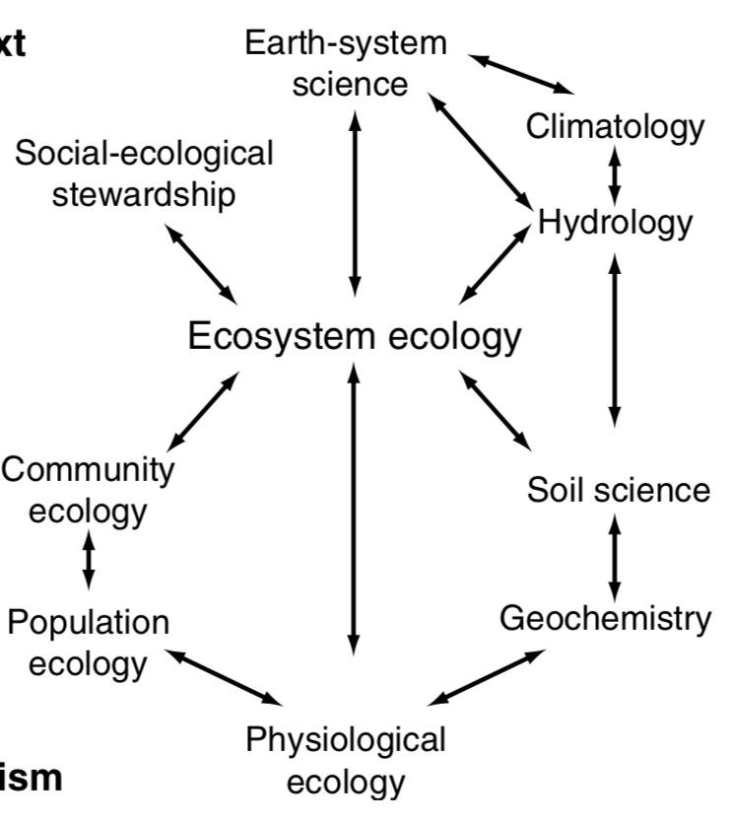

Slide 12
What is an ecosystem? Example?

Slide 13
How big is an ecosystem?

Slide 14
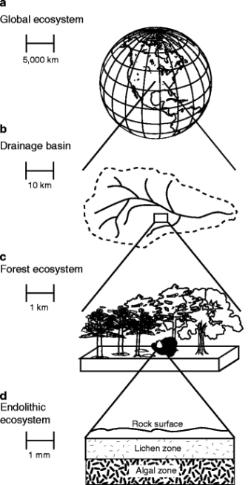
Ecosystems can vary in size!

Slide 15
Ecosystems can vary in size!
(but must include multiple organisms interacting with their abiotic and biotic environments)

Slide 16
Ecosystem Processes: “things an ecosystem does”

Slide 17
What are some examples of ecosystem processes?

Slide 18
Controls Over Ecosystem Processes
Hans Jenny (US soil scientist) in 1941 first to formalize a quantitative model of soil formation as well as the “state factors” that set the bounds for characteristics of an ecosystem:
S = f (climate, organisms, relief/topography, parent material, time)

Slide 19
Example: succession is the result of state factor changes

Slide 20
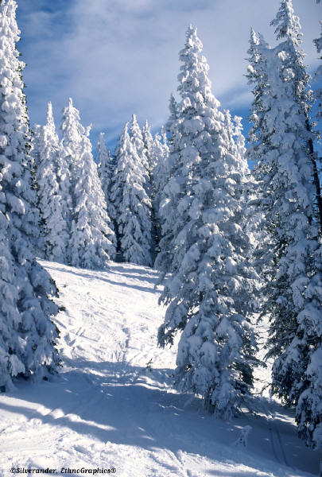
Cl
Climate
O
* Precipitation
* Temperature
R
P
T

Slide 21
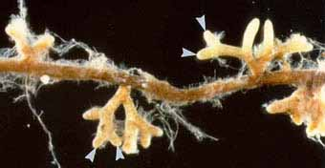
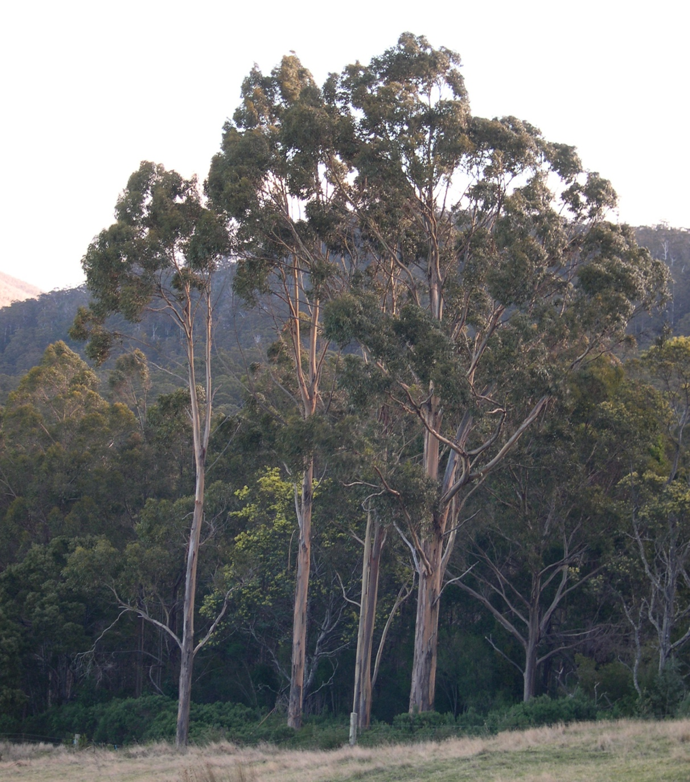
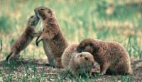
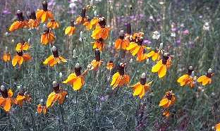
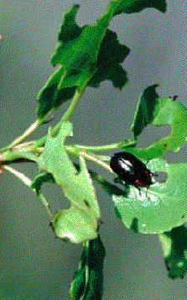
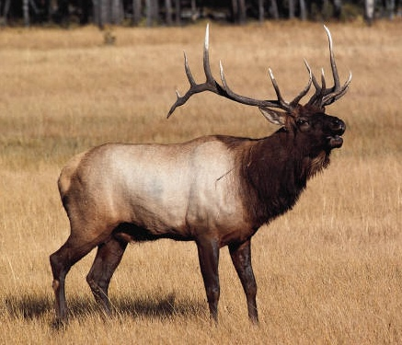
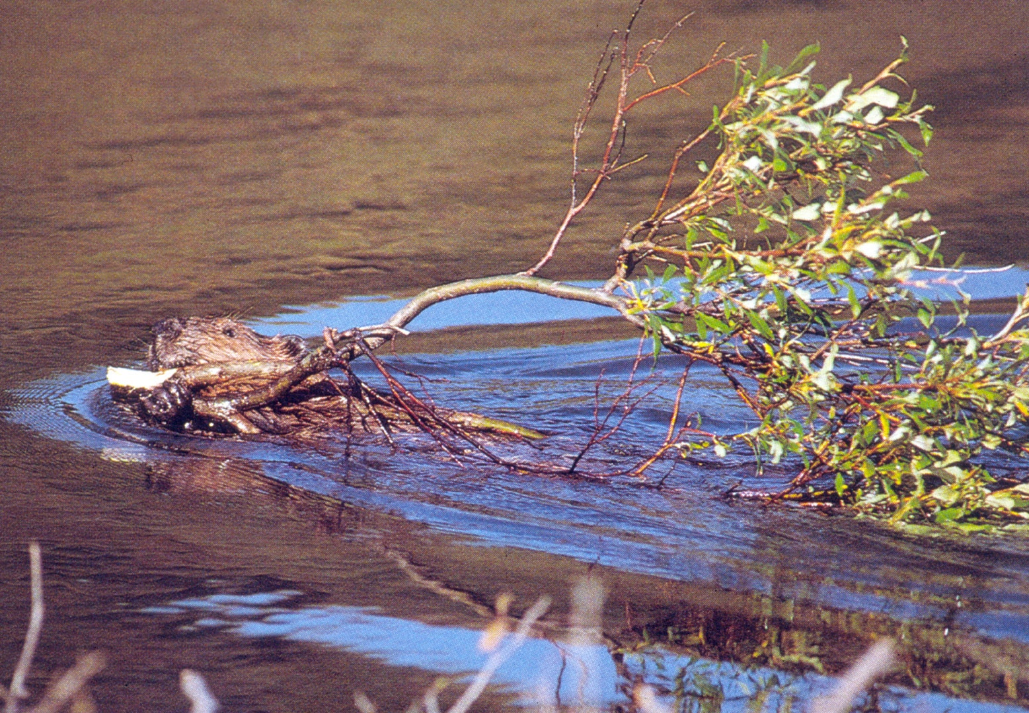
Cl
O
Organisms
R
P
T

Slide 22
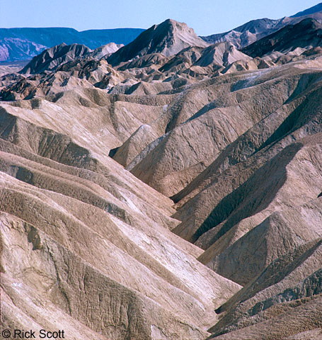
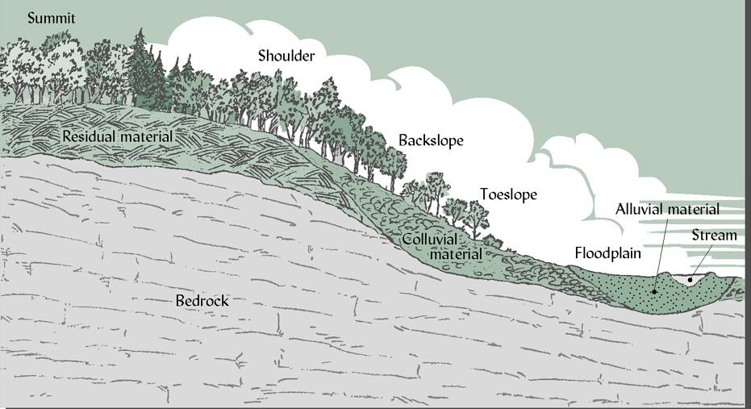
Cl
O
R
Relief/Topography
P
T

Slide 23
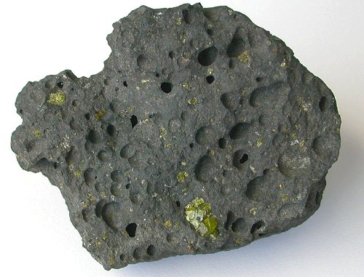
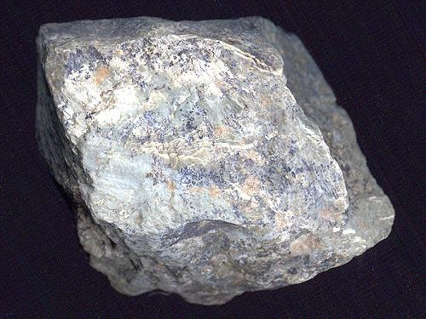
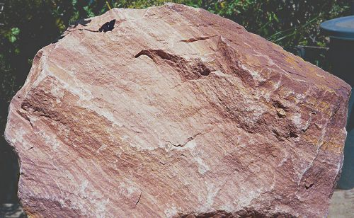
Cl
O
R
Igneous (basalt)
Metamorphic (schist)
P
Parent Material
T
Sedimentary (sandstone)

Slide 24
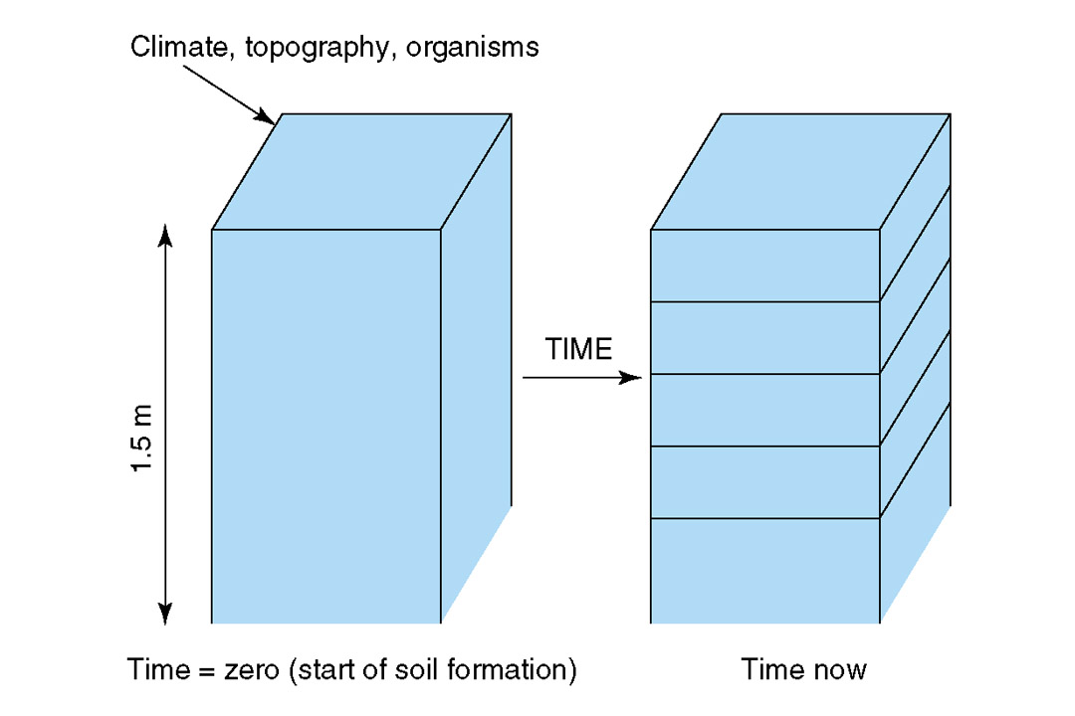
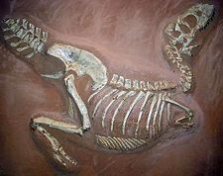
Cl
Development of Soil
O
R
Evolution
P
T
Time

Slide 25
Lake Michigan dunes

Slide 26
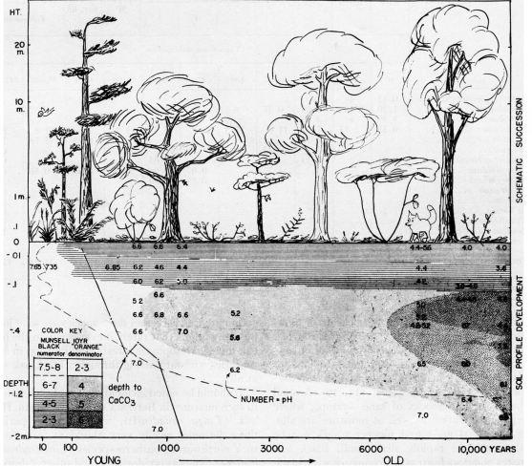
Lake Michigan dunes
Olson (1958)

Slide 27
Lake Michigan dunes
Beaches
Low nutrient environments
Unstable soils
Few plants (sea rocket)
Foredunes
Soil stabilized by grasses
Low nutrient soils
Grasses and wildflowers
Dune forests
Better soils
Competition is for light (tall plants)
Olson (1958)

Slide 28
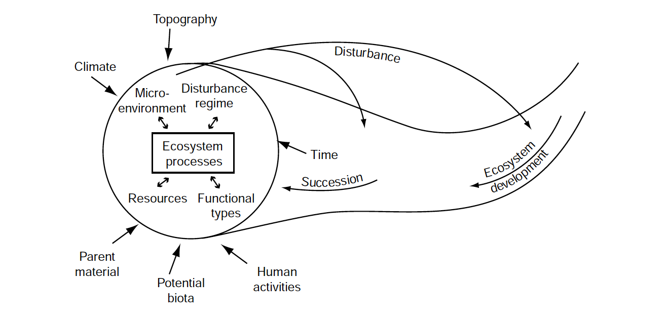
In your book, but modified from Chapin et al. (2006)

Slide 29
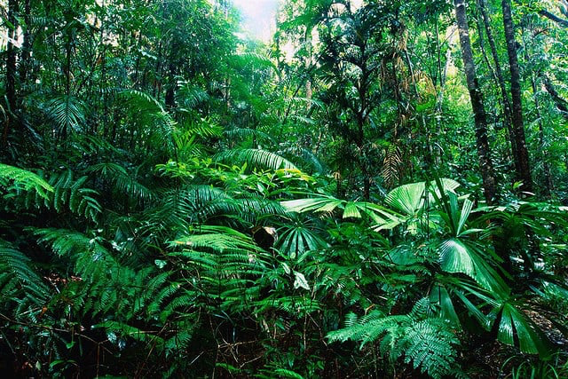
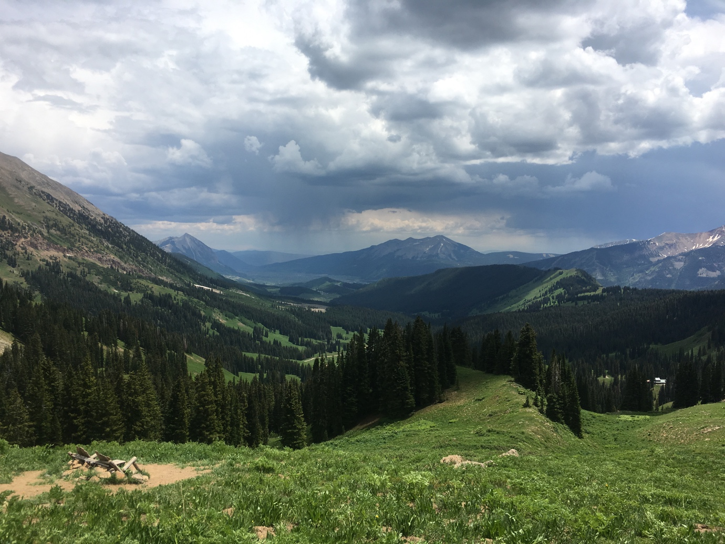
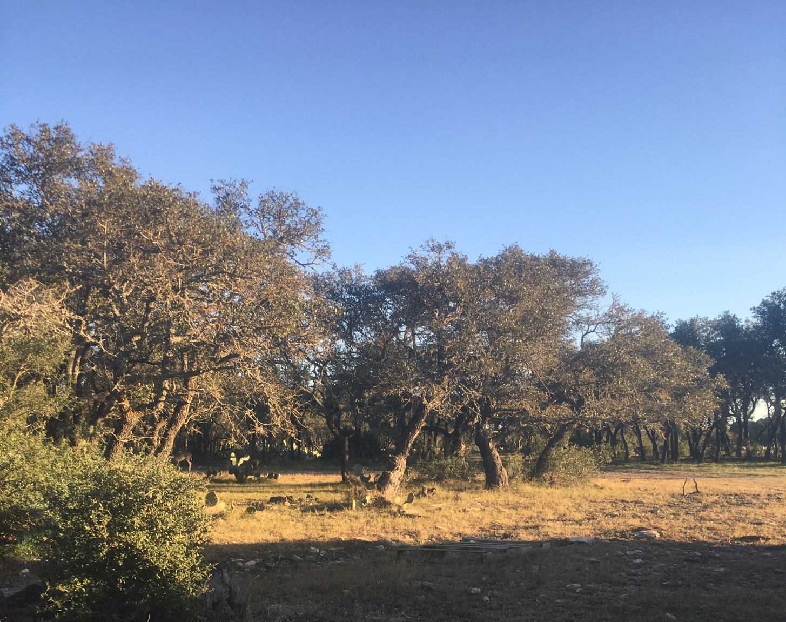

Slide 30


Climate
Wet --------- Dry

Slide 31
Organisms
Diverse --------- Depauperate

Slide 32
Topography
Steep --------- Flat

Slide 33
Parent Material
Igneous Sedimentary Basalt

Slide 34
Time
Old -------------- Recent

Slide 35
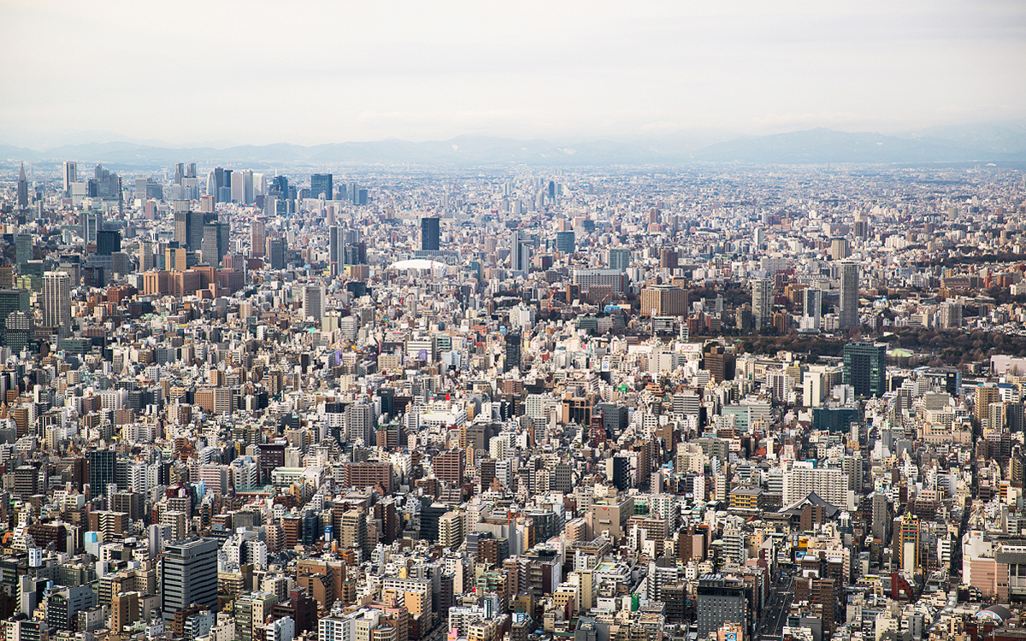
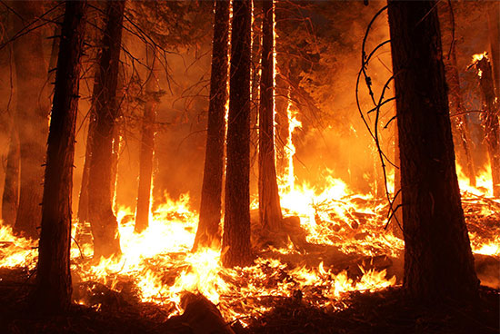
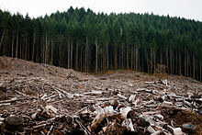
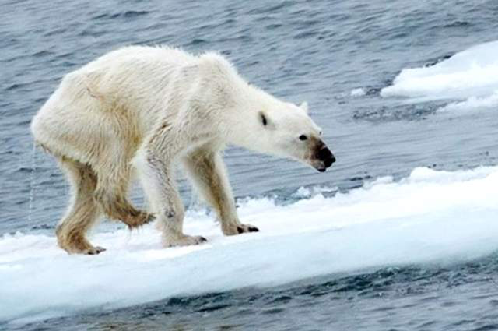

Slide 36
In your book, but modified from Chapin et al. (2006)

Slide 37
Ecosystem Services: “things an ecosystem provides”

Slide 38
What do humans get from ecosystems?

Slide 39
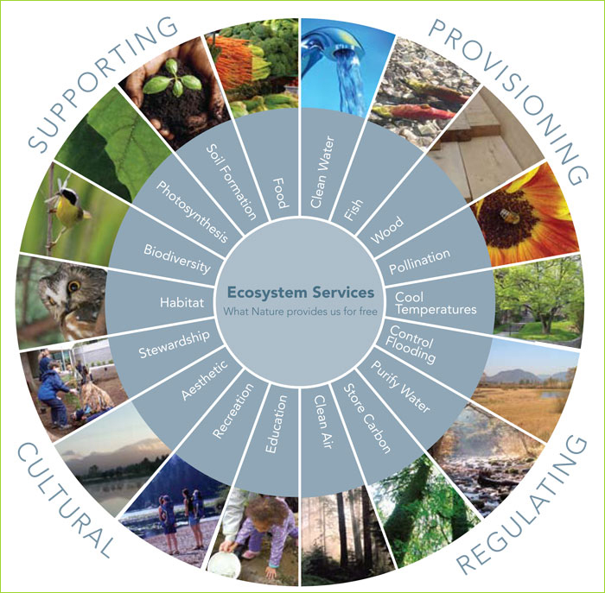
FNAL

Slide 40
Systems Thinking Exercise

Slide 41
Humans are altering things! What does this mean for an ecosystem?
Climate
Elevated CO2
Elevated Temperatures
More variable precipitation
Functional types
Invasive species
Woody encroachment
Disturbance regime
Fire frequency
Land clearing
Resources
Nutrient addition

Slide 42
Assignment (groups of 2-4)
Pick an ecosystem
Pick an anthropogenic disturbance
Use a box (pool) and arrow (flux) diagram to explain the effect on ecosystem processes and services
Climate
Elevated CO2
Elevated Temperatures
More variable precipitation
Functional types
Invasive species
Woody encroachment
Disturbance regime
Fire frequency
Land clearing
Resources
Nutrient addition

